Slide 1
COM2067/ COM267
Chapter 11: Multi-way Search Trees
Data Structures Using C, Second Edition

Slide 2
Introduction
B Trees
B+ Trees
2-3 Trees

Slide 3
Introduction
We have discussed that every node in a binary search tree contains one value and two pointers, left and right, which point to the node’s left and right sub-trees, respectively.
The structure of a binary search tree node is shown in Fig. 11.1.
The same concept is used in an M-way search tree which has M – 1 values per node and M subtrees.
In such a tree, M is called the degree of the tree. Note that in a binary search tree M = 2, so it has one value and two sub-trees.
In other words, every internal node of an M-way search tree consists of pointers to M sub-trees and contains M – 1 keys, where M > 2.
The structure of an M-way search tree node is shown in Fig. 11.2.

Slide 4
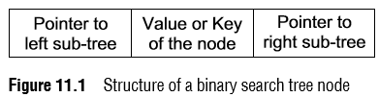

Introduction
In the structure shown, P₀, P₁, P₂, ..., P_{n} are pointers to
the node’s sub-trees and K₀, K₁, K₂, ..., K_{n–1} are the key values of the node.
All the key values are stored in ascending order.
That is, K_{i} < K_{i+1} for 0 ≤ i ≤ n–2.

Slide 5
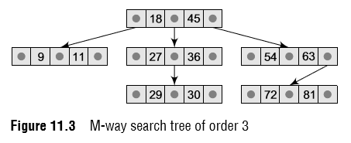
Introduction
In an M-way search tree, it is not compulsory that every node has exactly M–1 values and M subtrees.
Rather, the node can have anywhere from 1 to M–1 values, and the number of sub-trees can vary from 0 (for a leaf node) to i + 1, where i is the number of key values in the node.
M is thus a fixed upper limit that defines how many key values can be stored in the node.
Consider the M-way search tree shown in Fig. 11.3. Here M = 3.
So a node can store a maximum of two key values and can contain pointers to three sub-trees.

Slide 6
Introduction
In our example, we have taken a very small value of M so that the concept becomes easier for the reader, but in practice, M is usually very large.
Using a 3-way search tree, let us lay down some of the basic properties of an M-way search tree.
Note that the key values in the sub-tree pointed by P₀ are less than the key value K₀. Similarly, all the key values in the sub-tree pointed by P₁ are less than K₁, so on and so forth. Thus, the generalized rule is that all the key values in the sub-tree pointed by P_{i} are less than K_{i}, where 0 ≤ i ≤ n–1.
Note that the key values in the sub-tree pointed by P₁ are greater than the key value K₀. Similarly, all the key values in the sub-tree pointed by P₂ are greater than K₁, so on and so forth. Thus, the generalized rule is that all the key values in the sub-tree pointed by P_{i} are greater than K_{i–1}, where 0 ≤ i ≤ n–1. In an M-way search tree, every sub-tree is also an M-way search tree and follows the same rules.

Slide 7
B Trees
A B tree is a specialized M-way tree developed by Rudolf Bayer and Ed McCreight in 1970 that is widely used for disk access.
A B tree of order m can have a maximum of m–1 keys and m pointers to its sub-trees.
A B tree may contain a large number of key values and pointers to sub-trees.
Storing a large number of keys in a single node keeps the height of the tree relatively small.
A B tree is designed to store sorted data and allows search, insertion, and deletion operations to be performed in logarithmic amortized time.
A B tree of order m (the maximum number of children that each node can have) is a tree with all the properties of an M-way search tree.
In addition it has the following properties:
1. Every node in the B tree has at most (maximum) m children.
2. Every node in the B tree except the root node and leaf nodes has at least (minimum) m/2 children. This condition helps to keep the tree bushy so that the path from the root node to the leaf is very short, even in a tree that stores a lot of data.
3. The root node has at least two children if it is not a terminal (leaf) node.
4. All leaf nodes are at the same level.

Slide 8
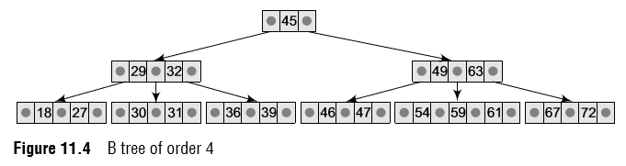
B Trees
An internal node in the B tree can have n number of children, where 0 ≤ n ≤ m.
It is not necessary that every node has the same number of children, but the only restriction is that the node should have at least m/2 children.
As B tree of order 4 is given in Fig. 11.4.
While performing insertion and deletion operations in a B tree, the number of child nodes may change.
So, in order to maintain a minimum number of children, the internal nodes may be joined or split.
We will discuss search, insertion, and deletion operations in this section.

Slide 9
B Trees
Searching for an element in a B Tree
Searching for an element in a B tree is similar to that in binary search trees.
Consider the B tree given in Fig. 11.4.
To search for 59, we begin at the root node.
The root node has a value 45 which is less than 59. So, we traverse in the right sub-tree.
The right sub-tree of the root node has two key values, 49 and 63. Since 49 ≤ 59 ≤ 63, we traverse the right sub-tree of 49, that is, the left sub-tree of 63.
This sub-tree has three values, 54, 59, and 61.
Since the running time of the search operation depends upon the height of the tree, the algorithm to search for an element in a B tree takes O(log_{t} n) time to execute.

Slide 10
B Trees
Inserting a New element in a B Tree
In a B tree, all insertions are done at the leaf node level.
A new value is inserted in the B tree using the algorithm given below.
1. Search the B tree to find the leaf node where the new key value should be inserted.
2. If the leaf node is not full, that is, it contains less than m–1 key values, then insert the new element in the node keeping the node’s elements ordered.
3. If the leaf node is full, that is, the leaf node already contains m–1 key values, then
(a) insert the new value in order into the existing set of keys,
(b) split the node at its median into two nodes (note that the split nodes are half full), and
(c) push the median element up to its parent’s node. If the parent’s node is already full, then split the parent node by following the same steps.

Slide 11
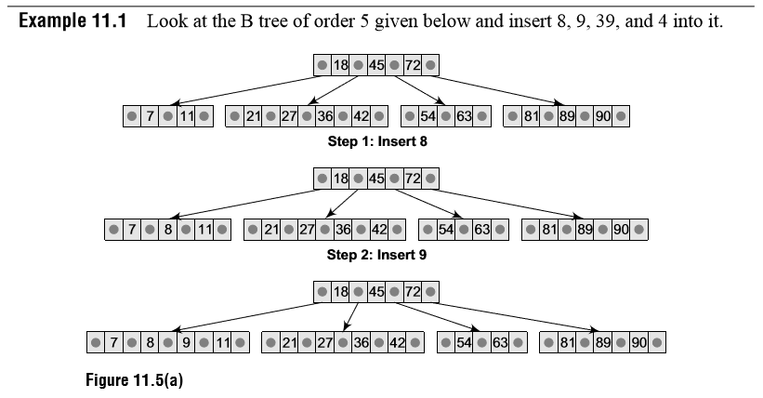
B Trees

Slide 12
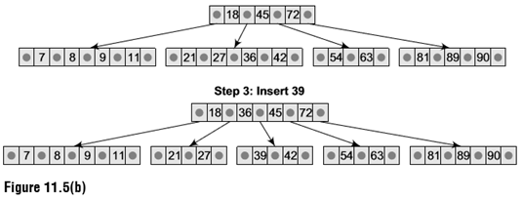
B Trees
Till now, we have easily inserted 8 and 9 in the tree because the leaf nodes were not full.
But now, the node in which 39 should be inserted is already full as it contains four values.
Here we split the nodes to form two separate nodes.
But before splitting, arrange the key values in order (including the new value).
The ordered set of values is given as 21, 27, 36, 39, and 42.
The median value is 36, so push 36 into its parent’s node and split the leaf nodes.

Slide 13
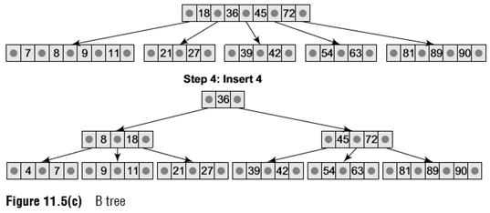
B Trees
Now the node in which 4 should be inserted is already full as it contains four key values.
Here we split the nodes to form two separate nodes.
But before splitting, we arrange the key values in order (including the new value).
The ordered set of values is given as 4, 7, 8, 9, and 11.
The median value is 8, so we push 8 into its parent’s node and split the leaf nodes.
But again, we see that the parent’s node is already full, so we split the parent node using the same procedure.

Slide 14
B Trees
Like insertion, deletion is also done from the leaf nodes.
There are two cases of deletion. In the first case, a leaf node has to be deleted.
In the second case, an internal node has to be deleted. Let us first see the steps involved in deleting a leaf node.
1. Locate the leaf node which has to be deleted.
2. If the leaf node contains more than the minimum number of key values (more than m/2 elements), then delete the value.
3. Else if the leaf node does not contain m/2 elements, then fill the node by taking an element either from the left or from the right sibling.
(a) If the left sibling has more than the minimum number of key values, push its largest key into its parent’s node and pull down the intervening element from the parent node to the leaf node where the key is deleted.
(b) Else, if the right sibling has more than the minimum number of key values, push its smallest key into its parent node and pull down the intervening element from the parent node to the leaf node where the key is deleted.

Slide 15
B Trees
4. Else, if both left and right siblings contain only the minimum number of elements, then create a new leaf node by combining the two leaf nodes and the intervening element of the parent node (ensuring that the number of elements does not exceed the maximum number of elements a node can have, that is, m). If pulling the intervening element from the parent node leaves it with less than the minimum number of keys in the node, then propagate the process upwards, thereby reducing the height of the B tree.
To delete an internal node, promote the successor or predecessor of the key to be deleted to occupy the position of the deleted key.
This predecessor or successor will always be in the leaf node.
So the processing will be done as if a value from the leaf node has been deleted.

Slide 16
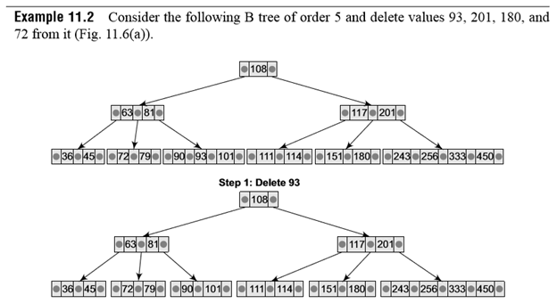
B Trees

Slide 17
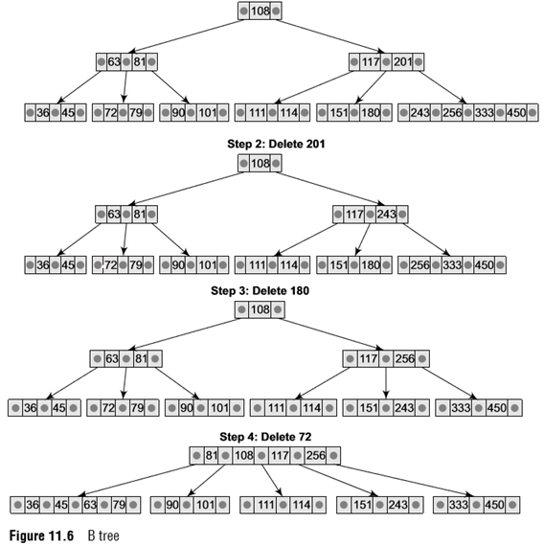
B Trees

Slide 18
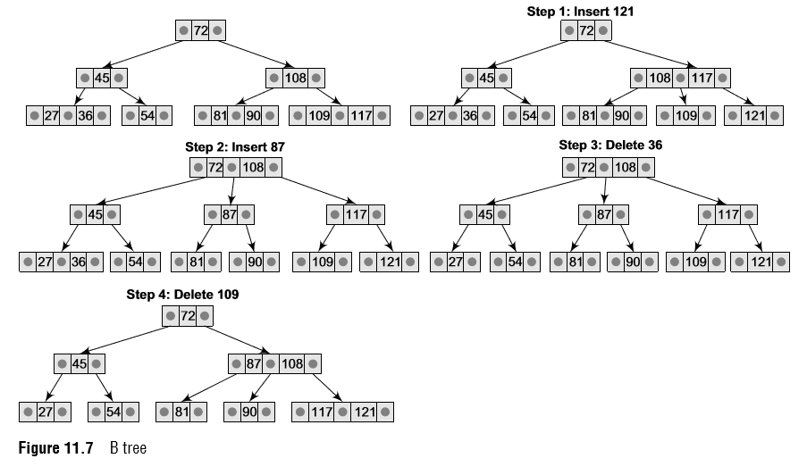
B Trees

Slide 19
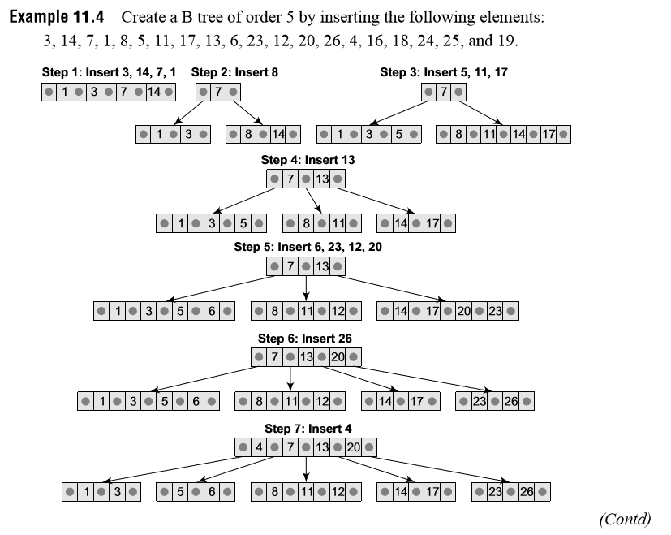
B Trees

Slide 20
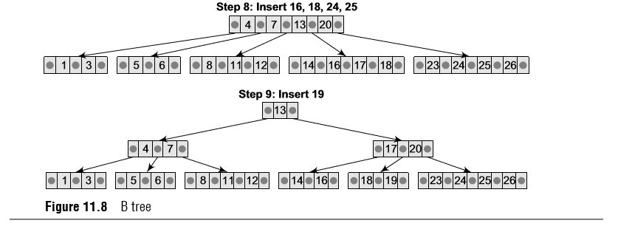
B Trees

Slide 21
B+ Trees
A B+ tree is a variant of a B tree which stores sorted data in a way that allows for efficient insertion, retrieval, and removal of records, each of which is identified by a key.
While a B tree can store both keys and records in its interior nodes, a B+ tree, in contrast, stores all the records at the leaf level of the tree; only keys are stored in the interior nodes.
The leaf nodes of a B+ tree are often linked to one another in a linked list.
Typically, B+ trees are used to store large amounts of data that cannot be stored in the main memory. With B+ trees, the secondary storage (magnetic disk) is used to store the leaf nodes of trees and the internal nodes of trees are stored in the main memory.
Many database systems are implemented using B+ tree structure because of its simplicity.
B+ trees store data only in the leaf nodes.
All other nodes (internal nodes) are called index nodes or i-nodes and store index values.
This allows us to traverse the tree from the root down to the leaf node that stores the desired data item.

Slide 22
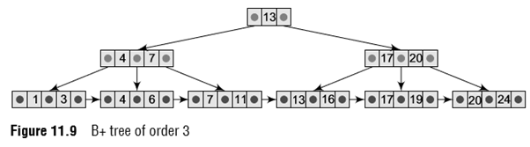
B+ Trees
Figure 11.9 shows a B+ tree of order 3.
Since all the data appear in the leaf nodes and are ordered, the tree is always balanced and makes searching for data efficient.
A B+ tree can be thought of as a multi-level index in which the leaves make up a dense index and the non-leaf nodes make up a sparse index.
The advantages of B+ trees can be given as follows:
1. Records can be fetched in equal number of disk accesses
2. It can be used to perform a wide range of queries easily as leaves are linked to nodes at the upper level
3. Height of the tree is less and balanced
4. Supports both random and sequential access to records
5. Keys are used for indexing

Slide 23
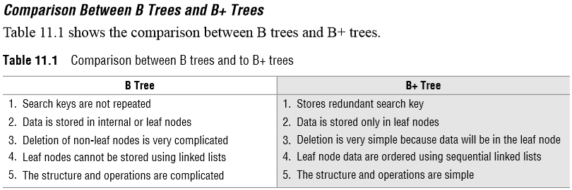
B+ Trees

Slide 24

B+ Trees
Inserting a New element in a B+ Tree
A new element is simply added in the leaf node if there is space for it.
But if the data node in the tree where insertion has to be done is full, then that node is split into two nodes.
This calls for adding a new index value in the parent index node so that future queries can arbitrate between the two new nodes.
However, adding the new index value in the parent node may cause it, in turn, to split.
In fact, all the nodes on the path from a leaf to the root may split when a new value is added to a leaf node.
If the root node splits, a new leaf node is created and the tree grows by one level.
The steps to insert a new node in a B+ Tree are summarized in Fig. 11.10.

Slide 25
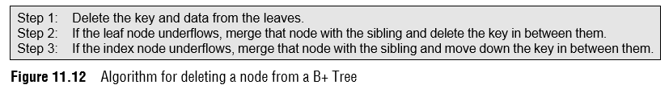
B+ Trees
Deleting an element from a B+ Tree
As in B trees, deletion is always done from a leaf node.
If deleting a data element leaves that node empty, then the neighboring nodes are examined and merged with the underfull node.
This process calls for the deletion of an index value from the parent index node which, in turn, may cause it to become empty.
Similar to the insertion process, deletion may cause a merge-delete wave to run from a leaf node all the way up to the root.
This leads to shrinking of the tree by one level. The steps to delete a node from a B+ tree are summarized in Fig. 11.12.

Slide 26
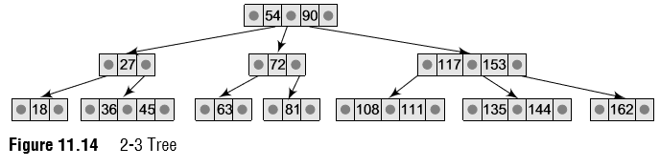
2-3 Trees
In the last chapter, we have seen that for binary search trees the average-case time for operations like search/insert/delete is O(log N) and the worst-case time is O(N) where N is the number of nodes in the tree.
However, a balanced tree that has height O(log N) always guarantees O(log N) time for all three methods.
Typical examples of height balanced trees include AVL trees, red-black trees, B trees, and 2-3 trees.
We have already discussed these data structures in the earlier chapter and section; now we will discuss 2-3 trees. In a 2-3 tree, each interior node has either two or three children.
Nodes with two children are called 2-nodes. The 2-nodes have one data value and two children
Nodes with three children are called 3-nodes. The 3-nodes have two data values and three children (left child, middle child, and a right child) This means that a 2-3 tree is not a binary tree. In this tree, all the leaf nodes are at the same level (bottom level).

Slide 27
2-3 Trees
Searching for an element in a 2-3 Tree
The search operation is used to determine whether a data value x is present in a 2-3 tree T.
The process of searching a value in a 2-3 tree is very similar to searching a value in a binary search tree.
The search for a data value x starts at the root. If k₁ and k₂ are the two values stored in the root node, then
if x < k1, move to the left child.
if x ≥ k1 and the node has only two children, move to the right child.
if x ≥ k1 and the node has three children, then move to the middle child if x < k₂ else to the right child if x ≥ k₂. At the end of the process, the node with data value x is reached if and only if x is at this leaf.

Slide 28
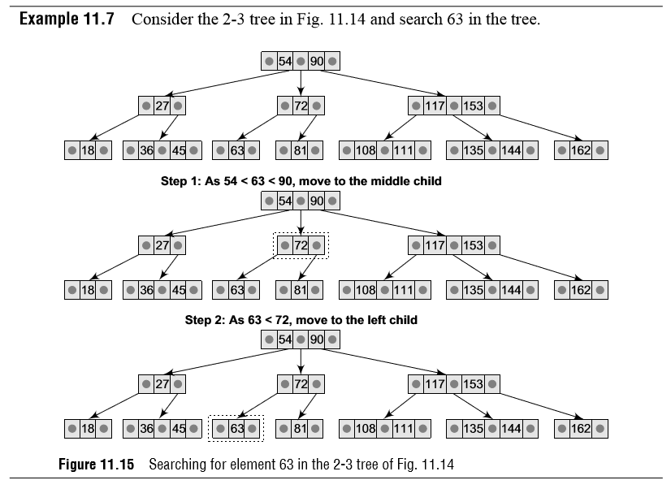
2-3 Trees

Slide 29
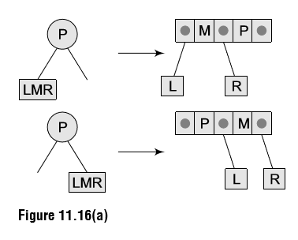
2-3 Trees
Inserting a New element in a 2-3 Tree
To insert a new value in the 2-3 tree, an appropriate position of the value is located in one of the leaf nodes.
If after insertion of the new value, the properties of the 2-3 tree do not get violated then insertion is over.
Otherwise, if any property is violated then the violating node must be split (Fig. 11.16).
Splitting a node A node is split when it has three data values and four children. Here, P is the parent and L, M, R denote the left, middle, and right children.

Slide 30
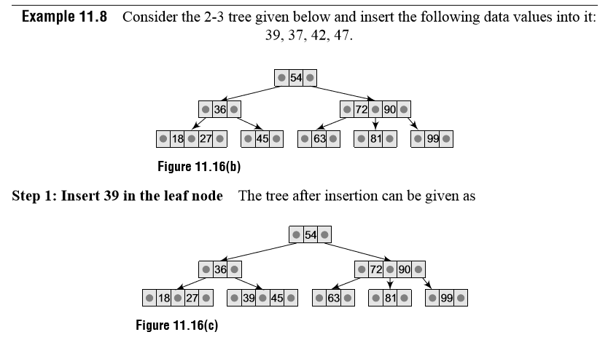
2-3 Trees

Slide 31
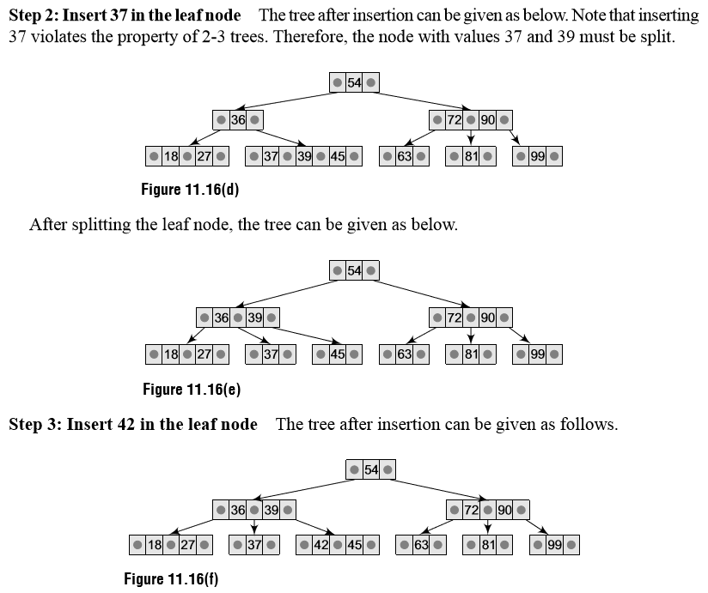
2-3 Trees

Slide 32
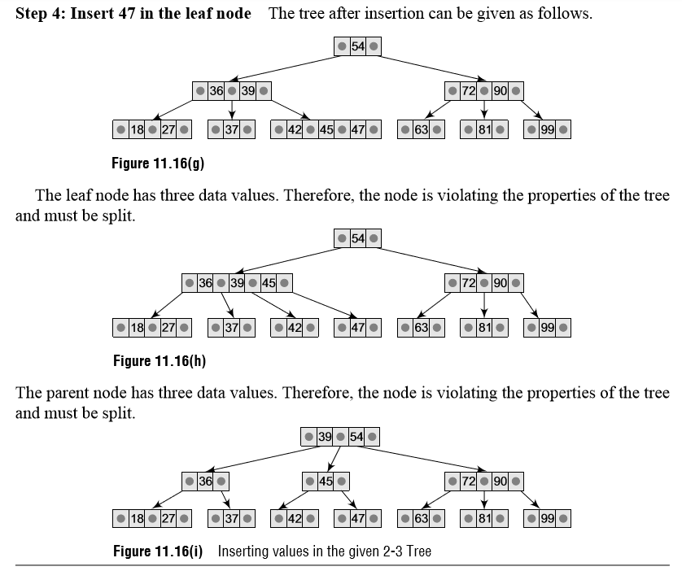
2-3 Trees

Slide 33
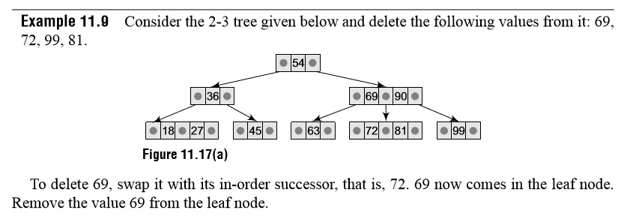
2-3 Trees
Deleting an element from a 2-3 Tree
In the deletion process, a specified data value is deleted from the 2-3 tree.
If deleting a value from a node violates the property of a tree, that is, if a node is left with less than one data value then two nodes must be merged together to preserve the general properties of a 2-3 tree.
In insertion, the new value had to be added in any of the leaf nodes but in deletion it is not necessary that the value has to be deleted from a leaf node.
The value can be deleted from any of the nodes.
To delete a value x, it is replaced by its in-order successor and then removed. If a node becomes empty after deleting a value, it is then merged with another node to restore the property of the tree.

Slide 34
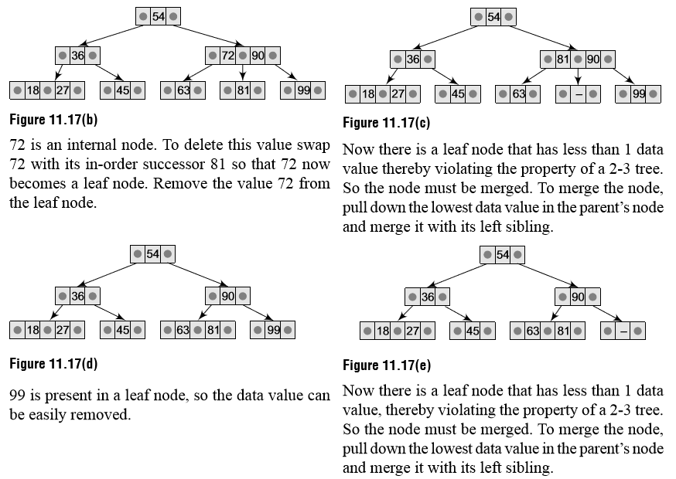
2-3 Trees

Slide 35
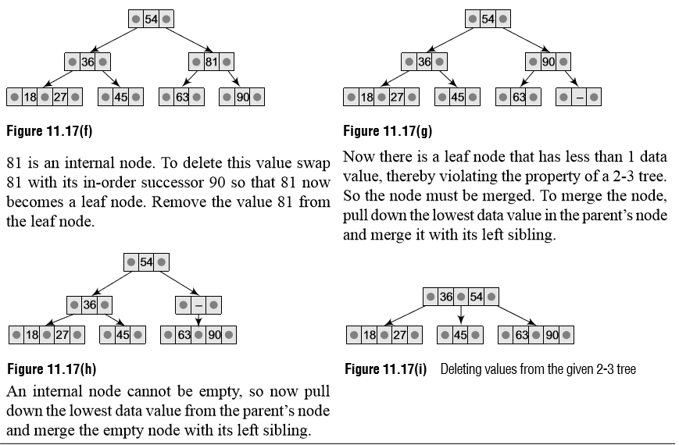
2-3 Trees

